Slide 1
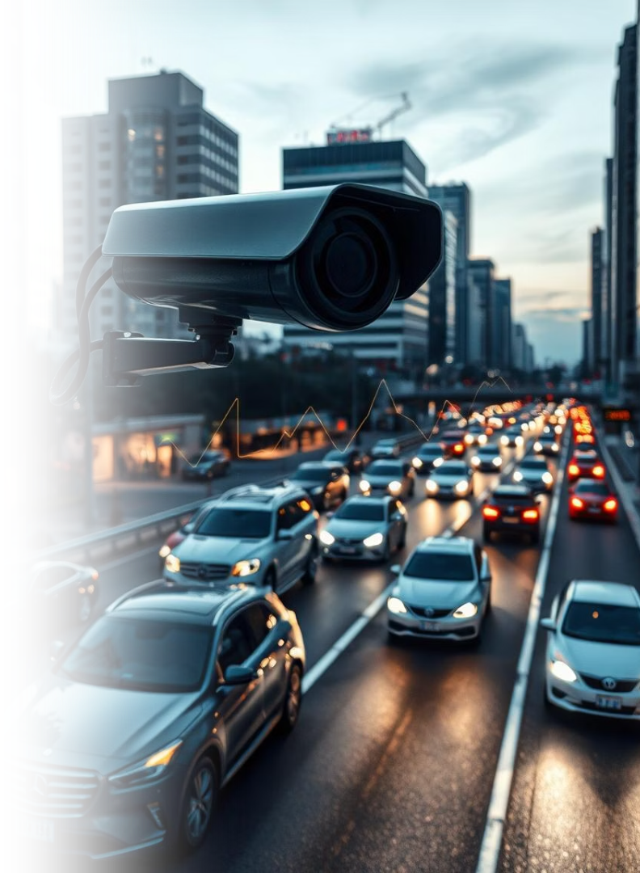

AUTOPACE Project Report
This report presents AUTOPACE, an AI-powered video analytics system designed to detect vehicles and estimate their speed using real-time object detection with YOLOv8 and OpenCV. The project aims to provide a cost-effective, scalable solution for intelligent traffic monitoring and law enforcement.
by Rounak Saha

Slide 2
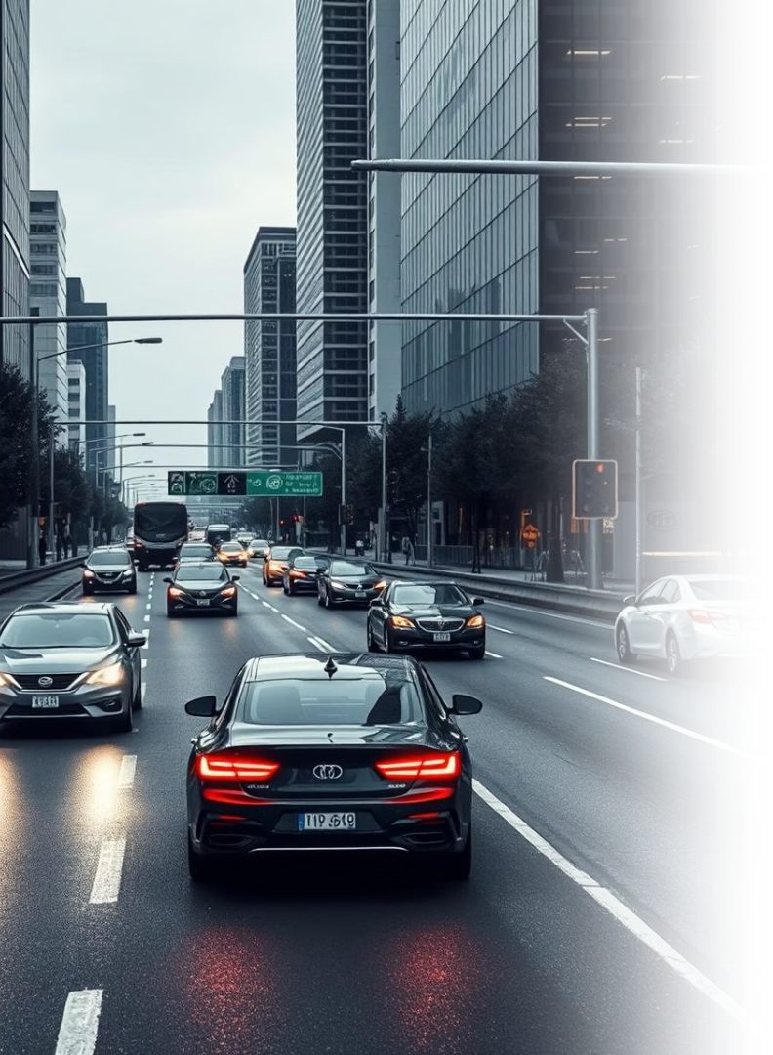
Introduction to AUTOPACE
Technology Stack
Application
Uses Python, OpenCV, YOLOv8, and Google Colab for cloud computation with minimal hardware requirements.
Designed for smart city surveillance, rule enforcement, and enhancing road safety through vehicle speed detection.
Processing Mode
Processes offline video files and supports both real-time and batch analysis scenarios.

Slide 3
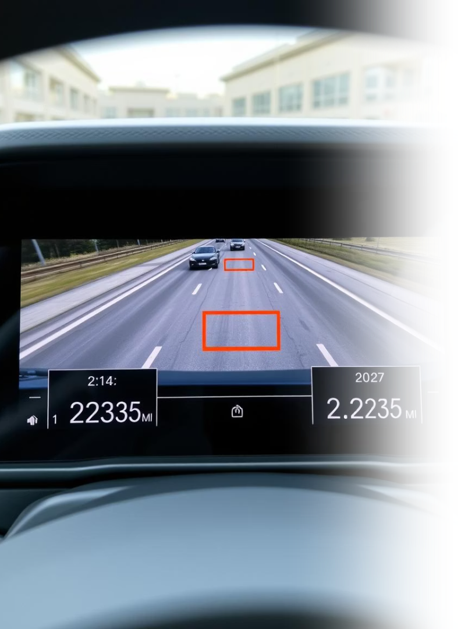
Project Objectives
Vehicle Detection
Detect vehicles in video streams using YOLOv8 object detection model.
Movement Tracking
Track vehicle movement across a defined virtual line in the frame.
Speed Calculation
Calculate and display the speed of each vehicle as it crosses the line.
Video Annotation
Annotate processed video with detection boxes and speed overlays for clarity.

Slide 4

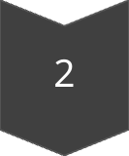
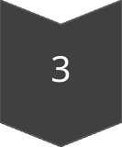
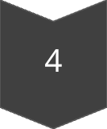

Methodology Overview
Data Input
User uploads traffic video in .mp4 or .avi format.
Model Loading
YOLOv8n model loaded via Ultralytics, deployed on GPU if available.
Detection & Tracking
Frames resized to 720p; cars detected and tracked crossing a virtual line.
Speed Calculation
Speed computed using time difference and known distance with formula Speed = (Distance/Time) × 3.6 km/h.
Annotation
Video annotated with bounding boxes and speed overlays, then saved.

Slide 5
Data Analysis and Results
Detection Accuracy
Speed Estimation
Visual Indicators
Vehicles detected with confidence scores logged for each frame.
Speeds calculated and displayed in real-time with acceptable accuracy for traffic monitoring.
Red horizontal line marks detection threshold; bounding boxes highlight detected cars.

Slide 6
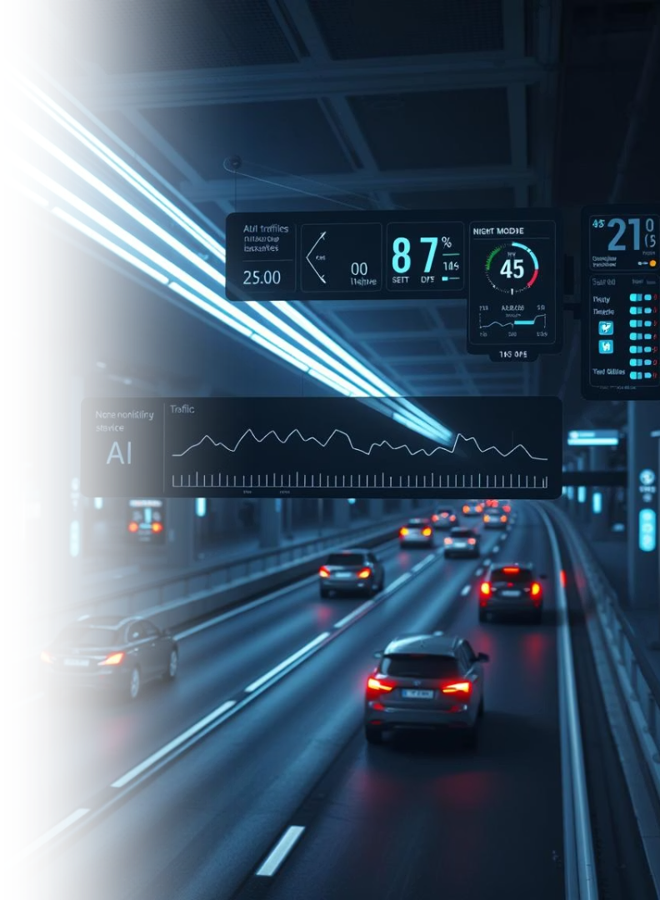
Conclusion and Future Work
Project Success
Performance
AUTOPACE demonstrates feasibility of lightweight computer vision for vehicle speed analysis from video.
System is robust, fast, and adaptable for real-time applications with minor enhancements.
Future Enhancements
Plans include integrating advanced tracking models and license plate recognition for enforcement.

Slide 7
Technical Tools and Frameworks
Python & OpenCV
YOLOv8
Google Colab
Core programming and image processing libraries used for video analysis and object detection.
Deep learning model for real-time object detection, optimized for vehicle identification.
Cloud-based platform enabling GPU acceleration and collaborative development.

Slide 8
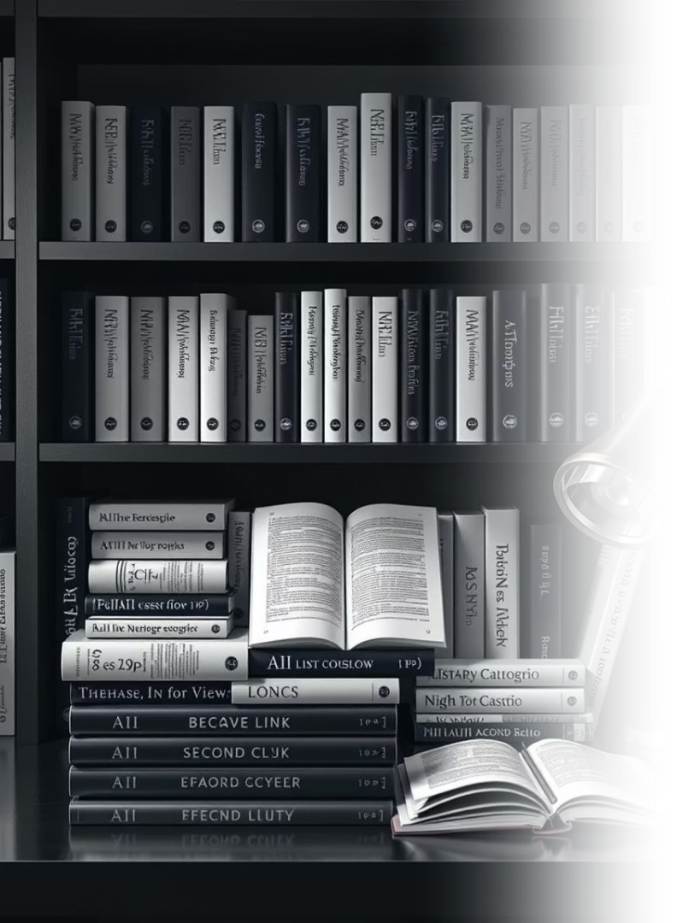
References and Resources
Ultralytics YOLOv8 Documentation
OpenCV Documentation
Torch Documentation
These resources provide foundational knowledge and technical support for the AUTOPACE project development and deployment.

